Slide 1


Understanding ChatGPT
Dr. Simon McCallum

Slide 2
AI - ML - LLMs - GPTs - GANNs - Diffusion - Deep learning
AI - Artificial Intelligence often taking inspiration from human intelligence
ML - Machine Learning making machines learn to do things
LLM - Large Language Models focused on solving language generation/understanding GPT - Generative Pre-trained Transformer a deep learning model
GANNs - Generative Adversarial Neural Networks a way of training NNs
Diffusion - Training a hidden representation and then regenerating a visual output from the hidden representation
Deep Learning - Multiple layers of Convolutional Neural Networks

Slide 3
ChatGPT a LLM
ChatGPT is a large language model.
Trained on Reddit, Wikipedia and a significant amount of the internet.
It does not “store” data, it learns the connections between words and concepts.
It was built on Language Translation - it is still very good at.
There is no Long term Memory. It does not have motivations or objectives.
It works out the next most likely output given context.
“The cat sat on the ____ “

Slide 4
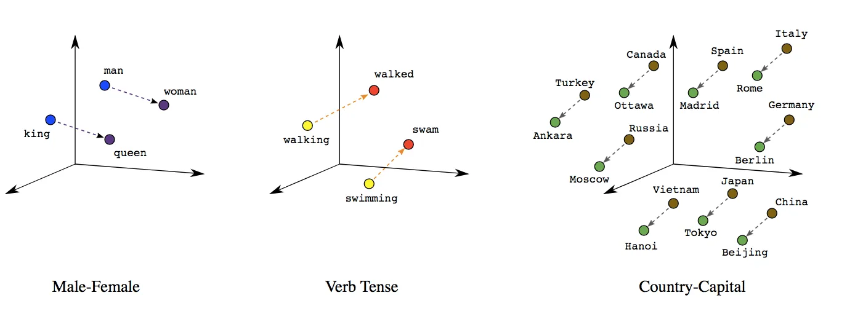
Understanding words - Vectors
Linear Relationships between Words. Image from developers.google.com

Slide 5

Attention
Word embeddings ( vectors )
Position of word
Multiple “bunches” of feedforward networks
Probability of producing a word
Non deterministic.

Slide 6
Working memory
ChatGPT has a working memory
Ask it a question with no context and it give a bland answer
Give it an interesting context and you get interesting results
Combination of Input and Output
Each output word is added to the input for the next calculation

Slide 7
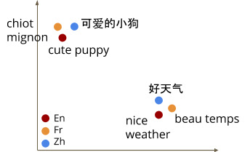
Build on translation
Construct the relationship between words
Build a cloud of “meaning” relationship between words
Find the abstract cloud and match it to another language
The embedding of languages align
Humans talk about the same stuff
May not work for alien languages?!?

Slide 8
Zero Shot vs Few Shot
Zero Shot = Ask it a question with no context
Few Shot = give it examples in the context, then let it use that structure to generate the next output!!!
Show it what a good answer looks like
Give it examples of your writing
Give it a rubric and an example

Slide 9
Building context - Prompt Engineering
What are they good at
Translating level of language - given an example create a shorter version ( the knowledge is in the context )
Creating stories ( word after word creative appending of sentences )
Provide insight into the “average” ending to a sentence
Many tools using GPT backend - just add words to the context
A button that adds - “Acting as a professional copy editor (__________)”
When editing set the “randomness” higher.
etc

Slide 10
Problems
Problem: Does not have good structure in its writing
Reason: Straight forward creation of content
Work around: Ask it to create the outline/structure - then ask it to fill in the details
Problem: Confidently makes up information
Reason: Creating a sentence that follows structure not meaning
Work around: BingChat/ GPT with plugins - ask it to evaluate the sentences it produces

Slide 11
AI creating Questions
Ask it to state which question is being answered in each paragraph of text
Then ask it to provide an answer to each question
Ask it what questions have been left unanswered by its description
Can students answer those questions?

Slide 12
Analogues
Translating conceptual space
Using structures in one domain to explain another
Very creative and novel, but usually correct mapping.
Explain supply and demand curves using rugby.
Help students understand using things they currently know.

Slide 13
AutoGPT
Uses python to all the LLM
Give it a problem
It asked GPT to create a plan
The code then steps though executing the plan.
Can be expensive $20 to solve a complex problem
But it can solve multistage challenges

Slide 14
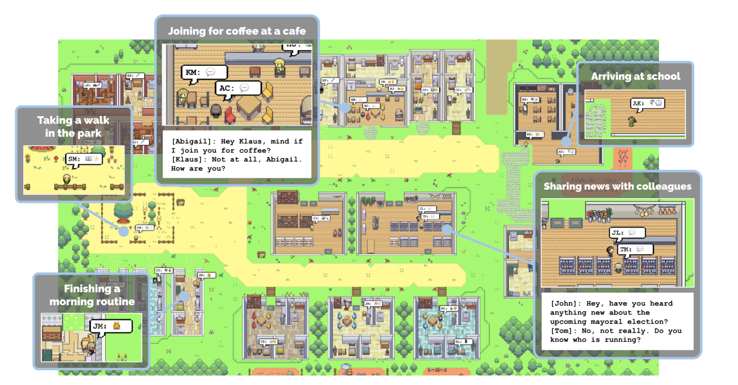
Cultural Simulation
Connect Sims to AI
They have motivations
They use language to communicate
Respond to language
You can talk to them
starting with only a single user-specified notion that one agent wants to throw a Valentine’s Day party, the agents autonomously spread invitations to the party over the next two days, make new acquaintances, ask each other out on dates to the party, and coordinate to show up for the party together at the right time
arXiv:2304.03442v1 [cs.HC] 7 Apr 2023 arXiv, April, 2023, J.S. Park, J.C. O’Brien, C.J. Cai, M. Morris, P. Liang, M.S. Bernstein

Slide 15
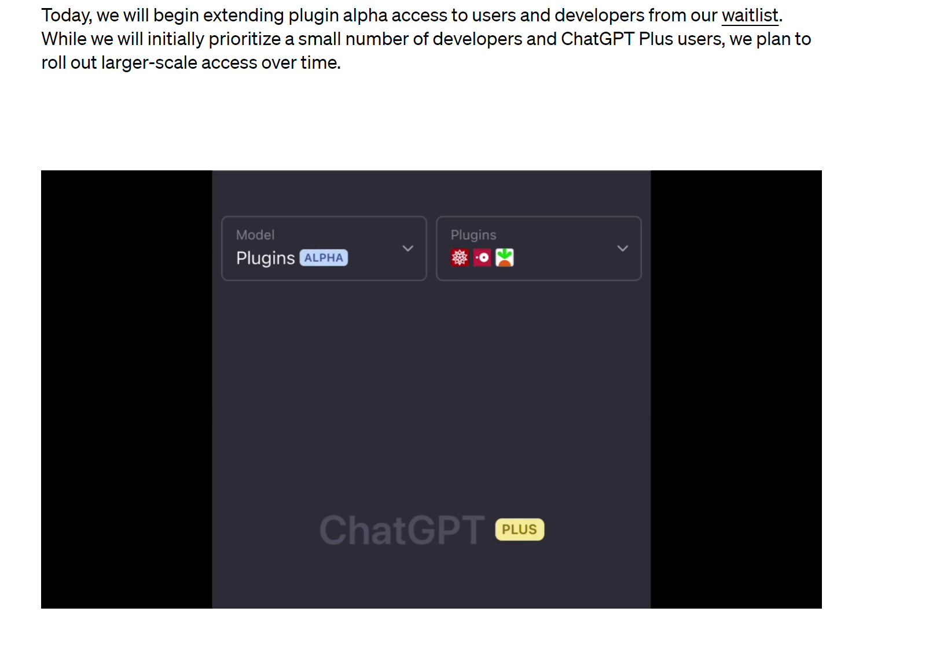
GPT-4 with plugins
Add LLMs to any task
Connect to the net
Get information
Send information
Interact with people
AI Safety?????

Slide 16
Art
Stable Diffusion https://dreamstudio.ai
Dall-E 2 - https://openai.com/product/dall-e-2
Nvidia AI playground - https://www.nvidia.com/en-us/research/ai-playground/

Slide 17
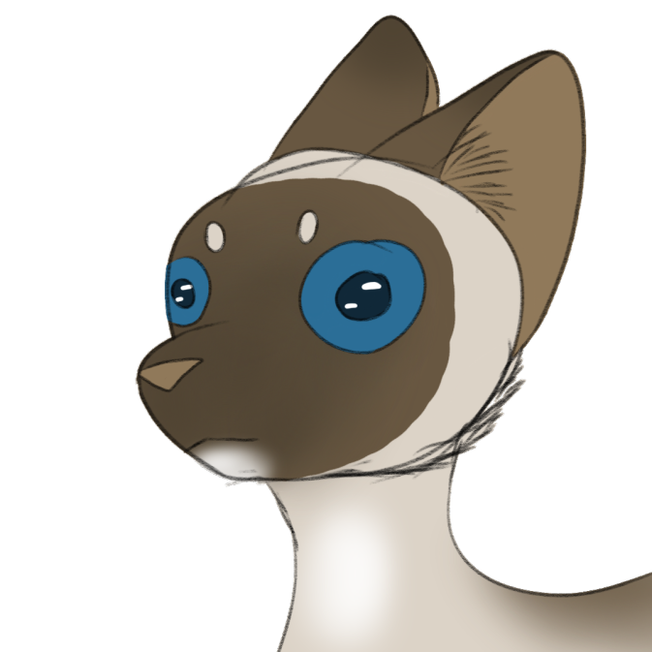
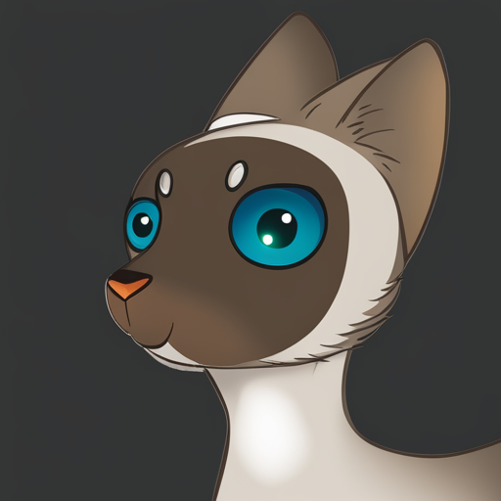
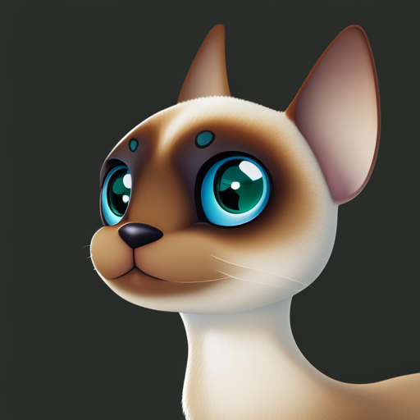
Art Diffusion

Slide 18
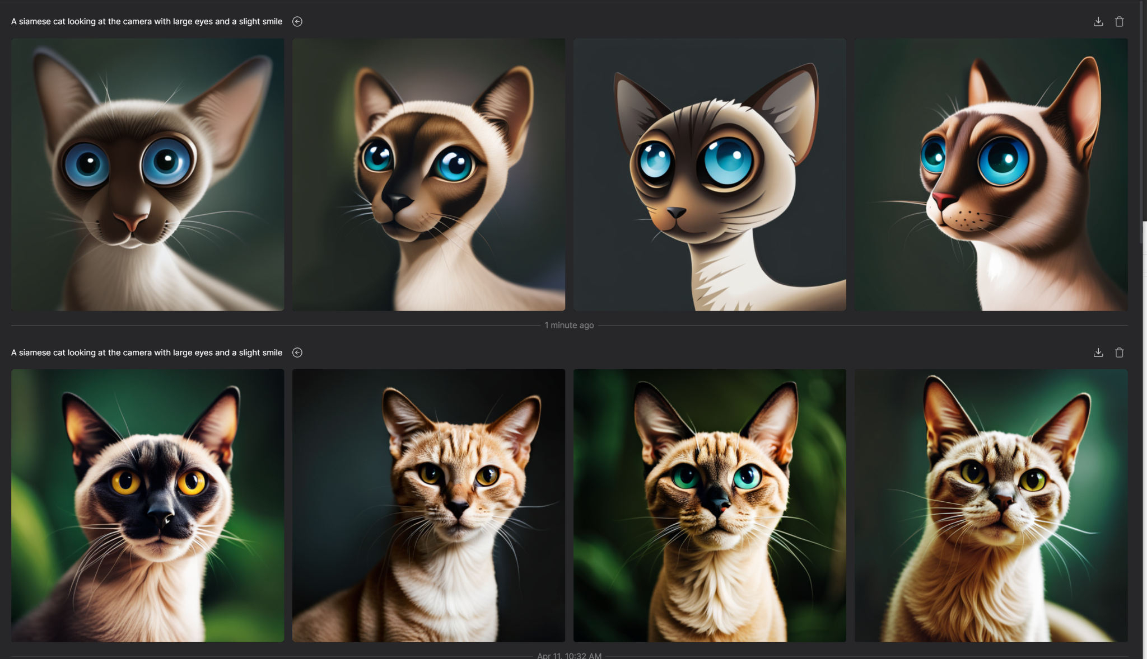
Creates variations and options

Slide 19



Implications for teaching
This is not a cheating tool, it is a Productivity Tool
Companies are already using this
We need to work out what is fundamental
Many tasks will become obsolete
Every assignment becomes a group assignment
Harder to convince students to do the work!!!
Rethink curriculum and assessment

Slide 20
GPT 4 - Short - Medium - Long
Make a table of the impact of Large Language Models on education focusing on productivity in the short, medium, and long term. The table should have rows of Students, Teachers and columns of short, medium and long. Each entry should have a 3 bullet points of the most important impacts that AI and language models could have on New Zealand secondary school education, and NCEA achievement
In the short term, students can benefit from improved study materials, instant feedback on assignments, and increased engagement in learning. Teachers will experience streamlined grading and feedback, enhanced classroom resources, and improved communication with students.
In the medium term, students will experience personalized learning paths, improved collaboration among students, and enhanced critical thinking skills. Teachers will be able to make data-driven decisions, tailor their instruction methods, and reduce their workload, thus preventing burnout.
In the long term, students will have lifelong learning support, develop higher-order thinking, and adapt to future job markets. Teachers will shift towards mentorship roles, enhance their professional development, and foster global educational networks.

Slide 21
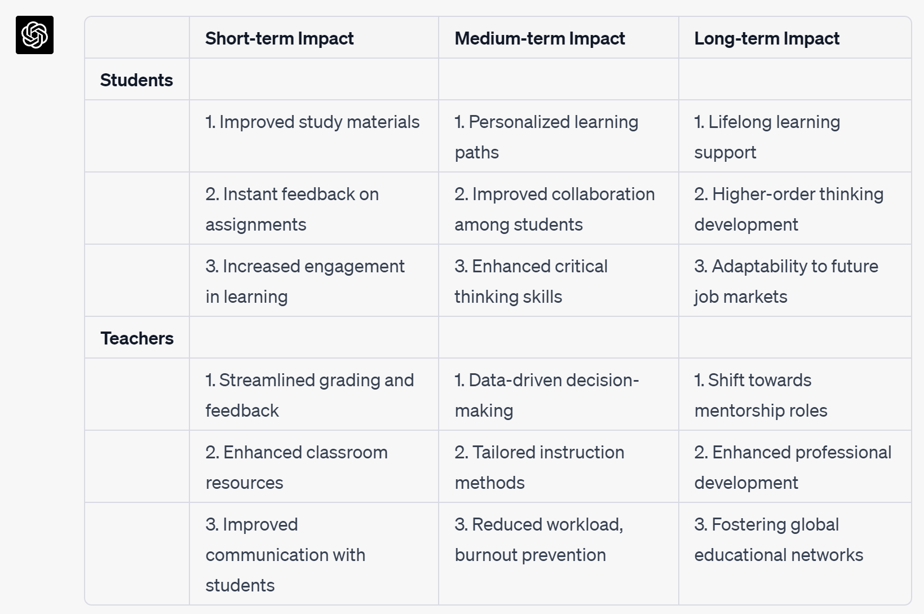

Slide 22
Good things
Translate any concept to a different level both up and down
Get tailored explanations of work given to it
Automate tasks
Students become Evaluators not creators
Teachers become Guides not oracles
Ask it to write using simpler words.
Extremely flexible.

Slide 23
Using LLMs
Create lesson plans - Anything that interprets words
Grade written work - give it a rubric and get a mark out
Challenge students to get the best out of the AI
Turning bullet points into full sentences
Providing the start of creative work
Think of training a DJ not a Musician

Slide 24
An art assistant
Create all the art assets for a story
If you are assessing language - allow AI art.
Interaction with the art created - out-fill art to finish it
Provide composition
Think of AI art as photography ( all the other aspects of composition matter)

Slide 25
Personal tutor
Give it text to ingest -
Ask it to write quiz questions.
Ask it to explain the text. Change the level.
Ask for similar knowledge systems
Have a conversation based on the characters
Write text and then ask it what you missed?

Slide 26
AI marking
Algorithmic marking for a long time
Ask the AI to write as a marker
Provide the rubric
Paste in the student work to mark
Get a mark out with and explanation
Feedback to parents about the mark - turn bullet points into phases

Slide 27
Principle
Grade what is relevant.
Understand the core function of the formative assessment.
Go back to the meta-knowledge goals
How confident are you in the knowledge?
Every project is a group project where the AI is one of the members
Defend your contribution to the project.

Slide 28
Q&A
Exchange of Knowledge
What are your challenges?
What are the possible solutions?
How do we work with students and run the ethics

Slide 29
News - 27/04
1 Million tokens
Hugging Chat - open source
ChatGPT allows removal of history
Replit - LLM model for coding
Nemo Guardrails
AutoGPT

